Slide 1

Developer management in Software House
Presenter: MUNIR ABBASI 20K-0244 MUSTAFA ZAHID 20K-1045 HASSAN ALI 20K-1052 RAZA ALI 20K-1061

Slide 2



Introduction
Today, we delve into a comparative analysis of two distinct IT organizations, Securiti.ai and One Technology Services USA, to explore the modern practices and employee experiences shaping the dynamic world of Information Technology.

Slide 3
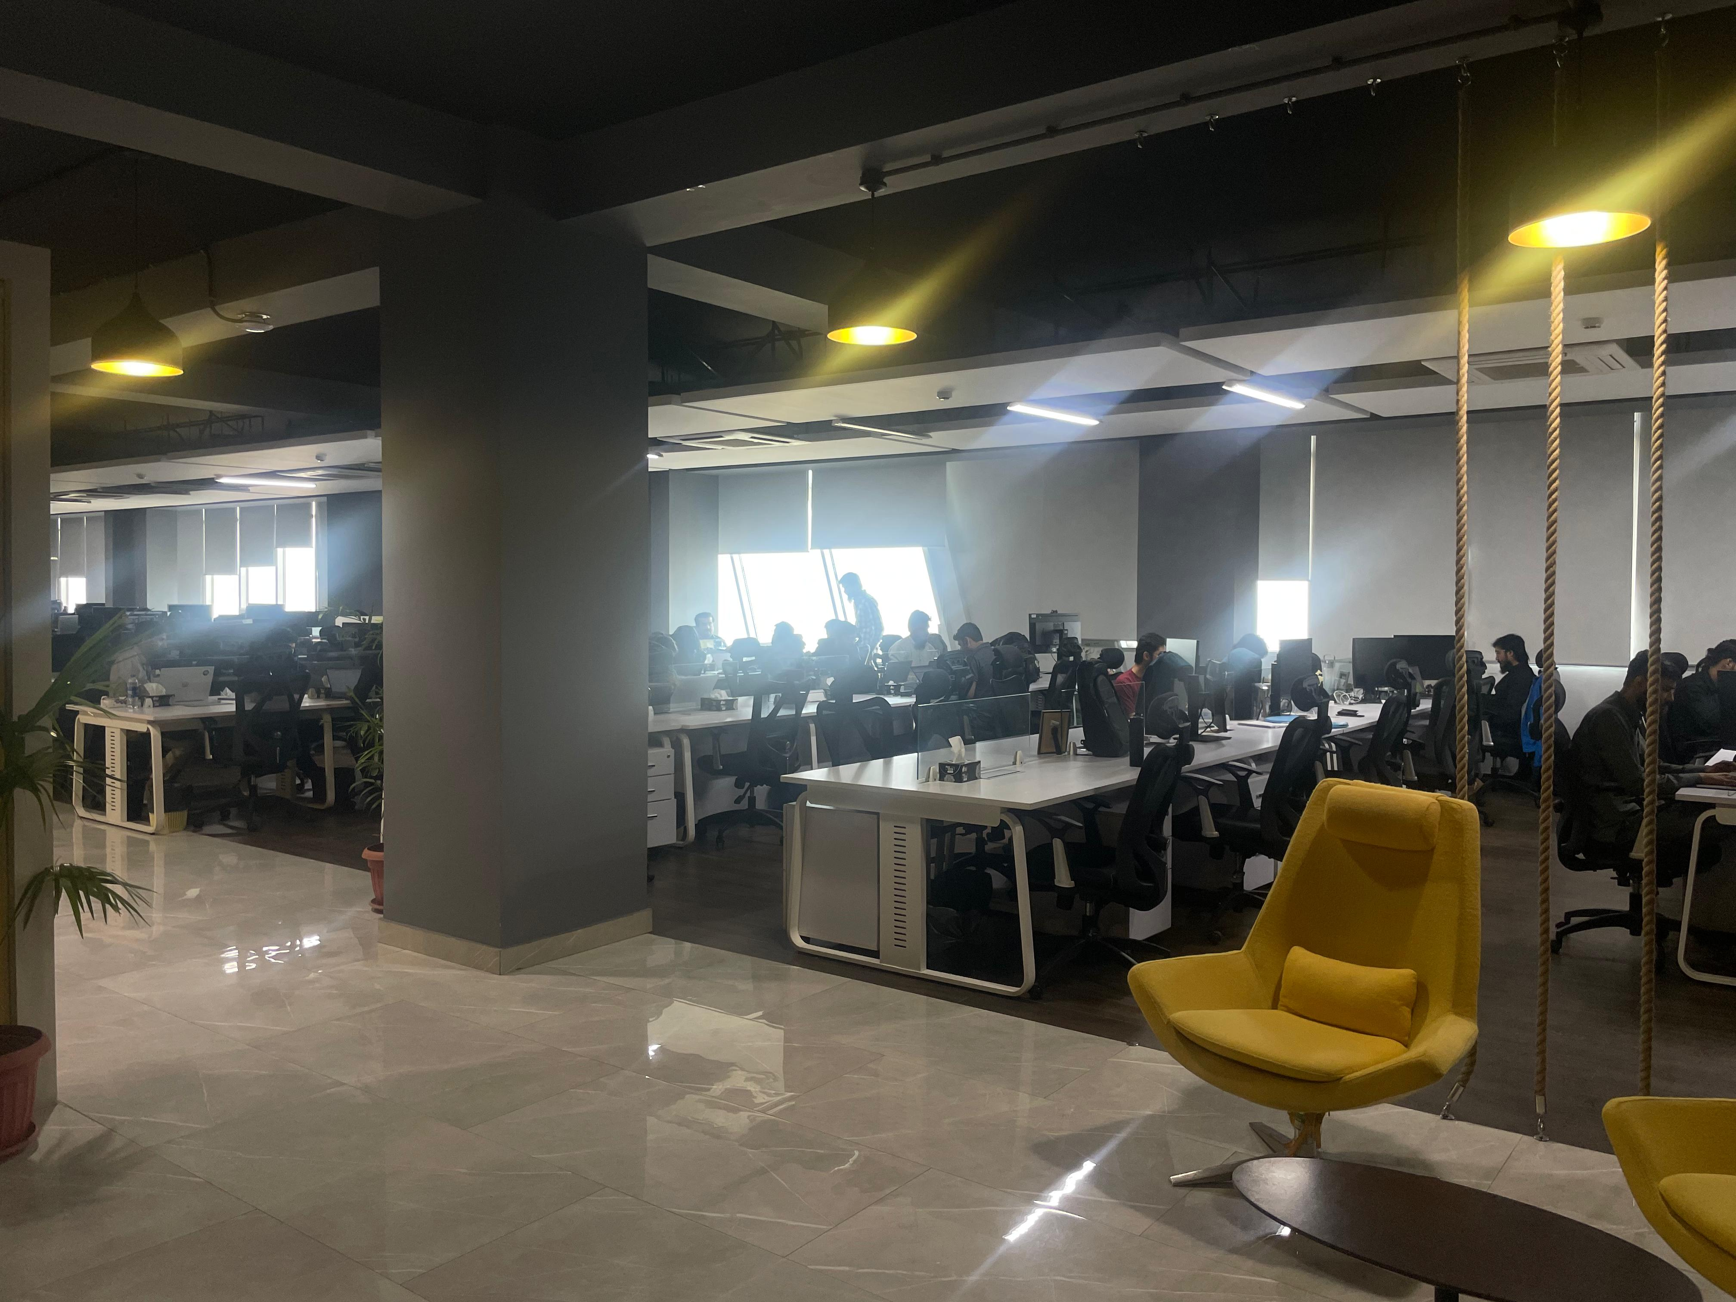
Introduction of Interviewed Organizations
Securiti.ai: A product-based company in San Jose, California, with 500+ employees globally, offices in multiple countries, and a focus on modern IT practices.
One Technology Services USA: A service-based company in Springfield with 150+ employees, project-based work, and reliance on legacy systems.

Slide 4

Form of interview:
In-person interviews conducted with software developers at both organizations.
Questionnaires designed for anonymous responses to gauge genuine employee sentiments

Slide 5
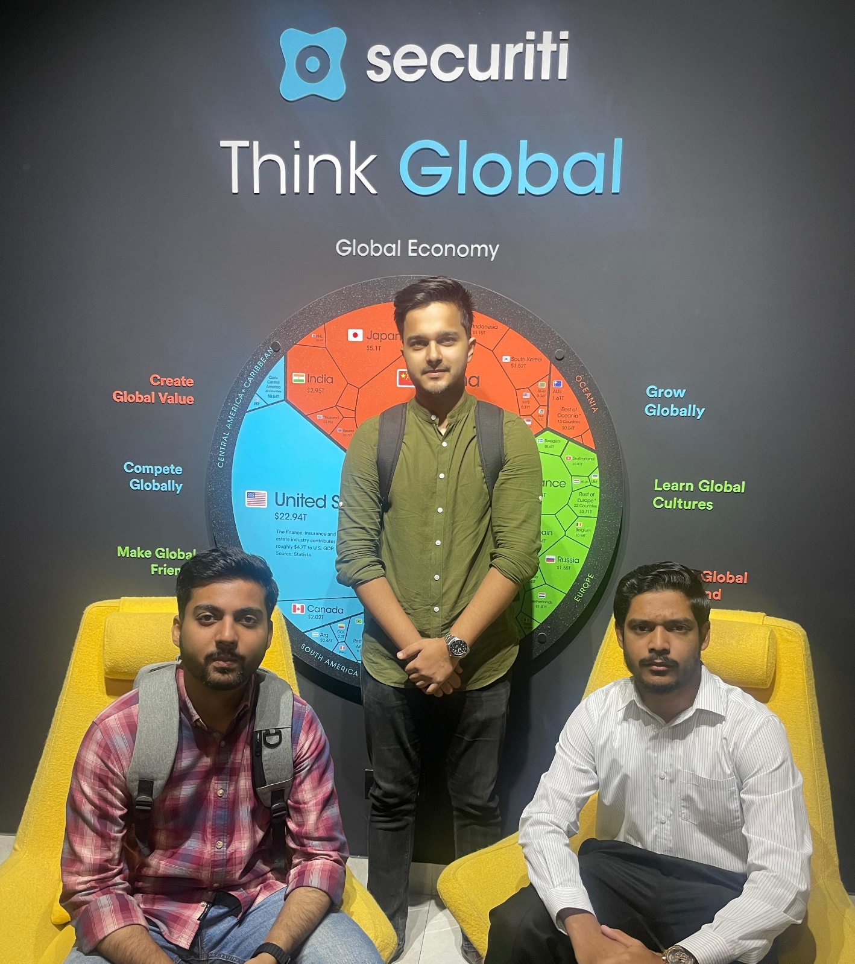
Questionnaire and Responses: Securiti.ai:
Positive emphasis on modern development processes.
Collaboration through tools like Slack, agile methodologies, and code reviews.
Strong focus on employee well-being, work-life balance, and continuous training.
Clear vision for future technologies, high morale among employees.

Slide 6

One Technology Services USA:
Reliance on legacy systems, bureaucratic processes, and waterfall development.
Limited training opportunities and slow feedback implementation.
Unpredictable work-life balance, lack of knowledge about future directions.

Slide 7
Comparative Analysis:
Development Processes:
Securiti.ai: Agile and iterative, collaborative, emphasis on code reviews.
One Technology Services USA: Waterfall, bureaucratic, manager-centric code reviews.
Training and Development:
Securiti.ai: Continuous training, sponsorships for certifications.
One Technology Services USA: Limited development programs, employees self- learn.
Work-Life Balance:
Securiti.ai: Hybrid model, flexible work arrangements, focus on well-being.
One Technology Services USA: Unpredictable, no paid leaves, surge in deliverables.

Slide 8
Comparative Analysis:
Standards and Procedures:
Securiti.ai: Implementation of standards like GDPR.
One Technology Services USA: Employees have room for making decisions themselves.
Employee Sentiments:
Securiti.ai: Ownership, Sense of Responsibility, employee recreational facilities
One Technology Services USA: Employee anxiety, self-management, all-around the job experience.
Management Satisfaction:
Securiti.ai: Strong sense of company values and family, collaboration and cooperation.
One Technology Services USA: Sense of disparity, lack of transparency.

Slide 9

Conclusion on Comparative Analysis:
Securiti.ai demonstrates modern practices, employee-centric approaches. Collaboration and ownership, limited learning.
One Technology Services USA relies on traditional methods, lacks innovation, good working environment.
Securiti.ai fosters a positive and collaborative culture, while One Technology Services USA faces challenges in employee engagement.

Slide 10


Feedback and Final Take:
Securiti.ai serves as a benchmark for modern IT practices.
Recommendations for One Technology Services USA include adopting newer technologies, streamlining processes, and focusing on employee well-being.
Comparative analysis highlights the importance of adapting to modern IT trends for organizational success.

Slide 11
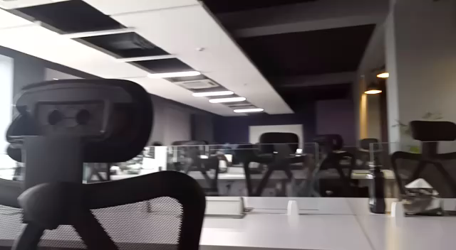

Slide 12

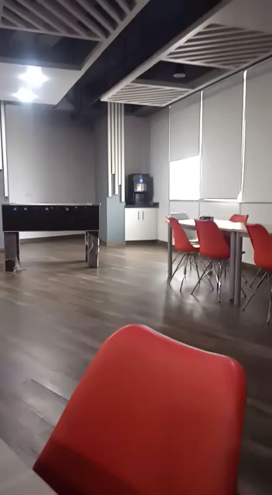

Slide 13

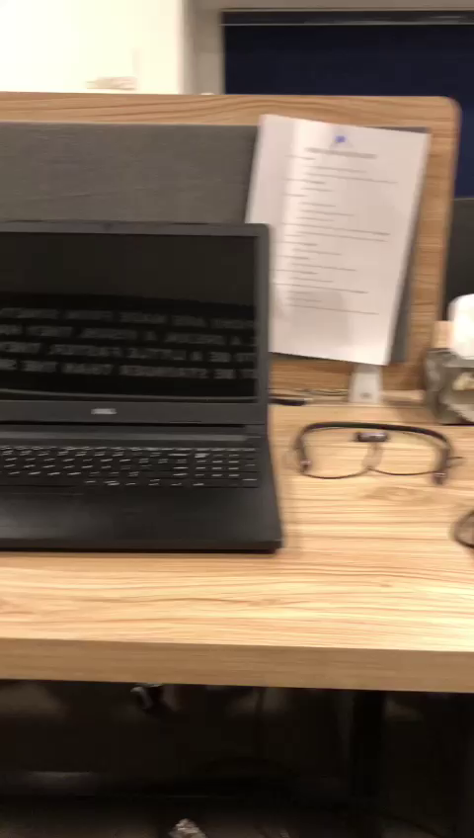

Slide 14




Thank you

